Slide 1

Black Friday Sales Predictions Using ML

Slide 2

Abstract
Black Friday marks the beginning of the Christmas shopping festival across the US. On Black Friday big shopping giants like Amazon, Flipkart, etc. lure customers by offering discounts and deals on different product categories.
The product categories range from electronic items, Clothing, kitchen appliances, Décor. Research has been carried out to predict sales by various researchers. The analysis of this data serves as a basis to provide discounts on various product items.
With the purpose of analyzing and predicting the sales, we have used three models. The dataset Black Friday Sales Dataset available on Kaggle has been used for analysis and prediction purposes.

Slide 3

Contents
Introduction
Existing System
Disadvantages of Existing System
Proposed System
Advantages of Proposed System
System Architecture
System Requirements
Algorithm
List of Modules
Module 1, 2, 3, 4
Final Output
Conclusion
Future Scope
References

Slide 4

Introduction
The shopping sector has greatly evolved due to the Internet revolution. Most of the population takes into consideration online shopping more than the traditional method of shopping.
The biggest perks of online shopping are convenience, better prices, more variety, easy price comparisons, no crowds, etc.
The result of which will enable the end-user to make better decisions, ability to predict future sales, increase the production dependencies on the demand, and also regional sales can be calculated.

Slide 5
Existing System
Making analysis of behavior on Black Friday highlighting the attributes like occupation, martial status affecting the sales on the day of Black Friday using Conventional methods.
Explained how the visualization can affect the psychology of customers and marketing. They have discussed about the features like environment color which can enhance customer feeling, and purchase likelihood.
Research methods combining qualitative and quantitative sampling, data collection and older analysis techniques manually.

Slide 6
Disadvantages of Existing System
Of all the above study, we found that there is a lack of experimentation for various types of dataset splits.
It takes lot of time to analyse the data for predictions.
It may not maintain a good accuracy of the predictions.
A small change in dataset may take lot of time for the change in process.

Slide 7
Proposed System
Sales prediction on black Friday dataset is analyzed here.
The proposed approach tries to implement the machine learning model such as Random Forest Regressor.
Data visualization and data analysis is proposed.
A prediction model to analyze the customer's past spending and predict the future spending of the customer.
The performance evaluation measure Root Mean Squared Error (RMSE) is used to evaluate the models used.

Slide 8

Advantages of Proposed System
High accuracy of data prediction.
Regression found to be useful model for black Friday sales dataset.
More predictions in less time and fast performance.
We can know whether the sales are on up to the mark or not.

Slide 9

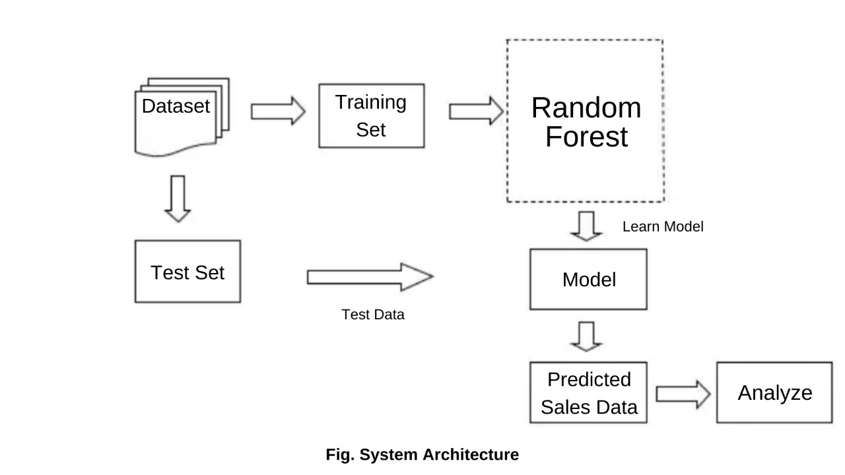
System Architecture

Slide 10

System Requirements
Hardware Requirements
OS of Windows 7,8,10(32-bit and 64-bit)
RAM - 4gb
Software Requirements
Anaconda navigator software
Jupyter notebook editor window in python language

Slide 11
Algorithm
RandomForestRegressor
Steps involved in random forest algorithm:
Step 1: In Random forest n number of random records are taken from the data set having k number of records.
Step 2: Individual decision trees are constructed for each sample.
Step 3: Each decision tree will generate an output.
Step 4: Final output is considered based on Majority Voting or Averaging for Classification and regression respectively

Slide 12
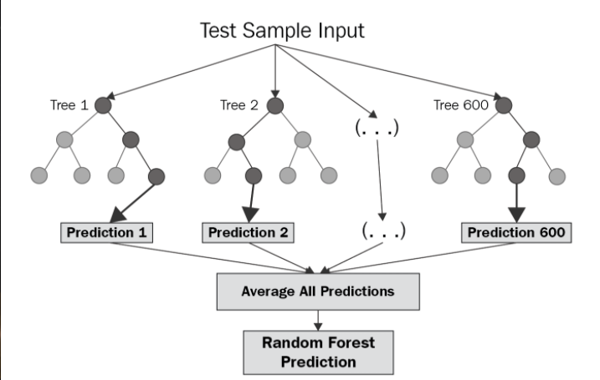
RandomForestRegressor

Slide 13

List Of Modules
Data collection
Data preprocessing
Feature extraction
Evaluation model

Slide 14
Module 1
Data collection: This dataset includes past sales records with attributes. All this attributes are main attributes which are related to sales .
And also some attributes has high correlation with dependent variable

Slide 15
Module 2
Dataset preprocessing: Organize your selected data by formatting, cleaning and sampling from it. Three common data pre-processing steps are: Formatting, Cleaning, Sampling.

Slide 16
Module 3
Feature extraction: Next thing is to do Feature extraction is an attribute reduction process. Unlike feature selection, which ranks the existing attributes according to their predictive significance, feature extraction actually transforms the attributes. The transformed attributes, or features, are linear combinations of the original attributes.

Slide 17
Module 4
Evaluation model: Model Evaluation is an integral part of the model development process. It helps to find the best model that represents our data and how well the chosen model will work in the future. Evaluating model performance with the data used for training is not acceptable in data science because it can easily generate over optimistic and over fitted models.

Slide 18
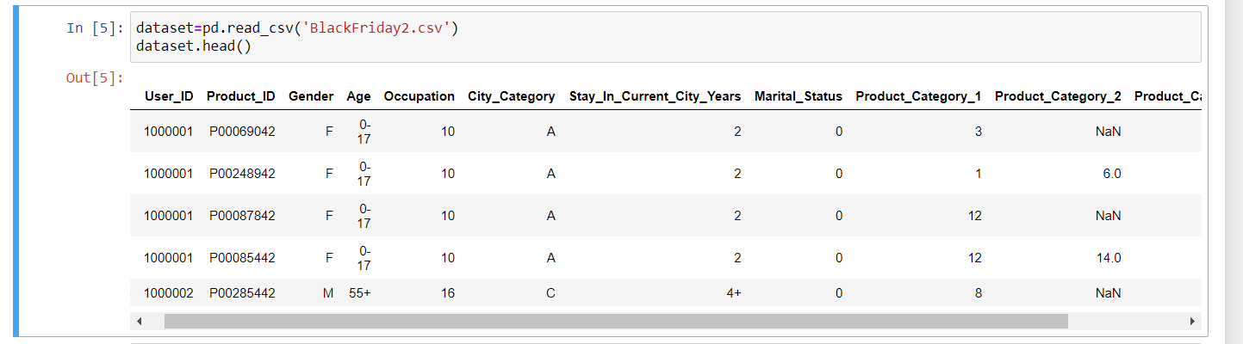
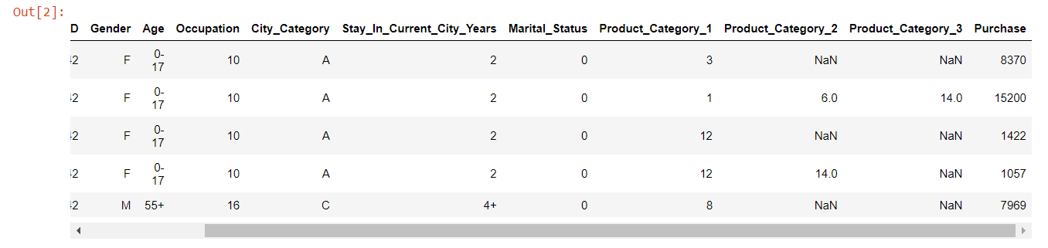
Module 1 Output

Slide 19
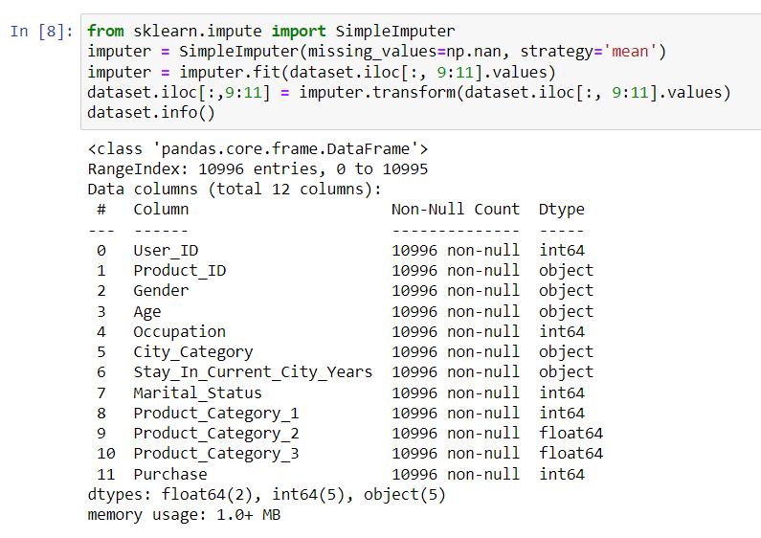
Module 2 Output

Slide 20
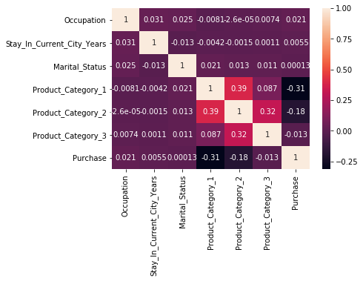
Module 3 Output
Seaborn Heatmap

Slide 21
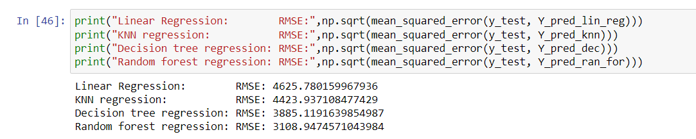
Module 4 Output

Slide 22
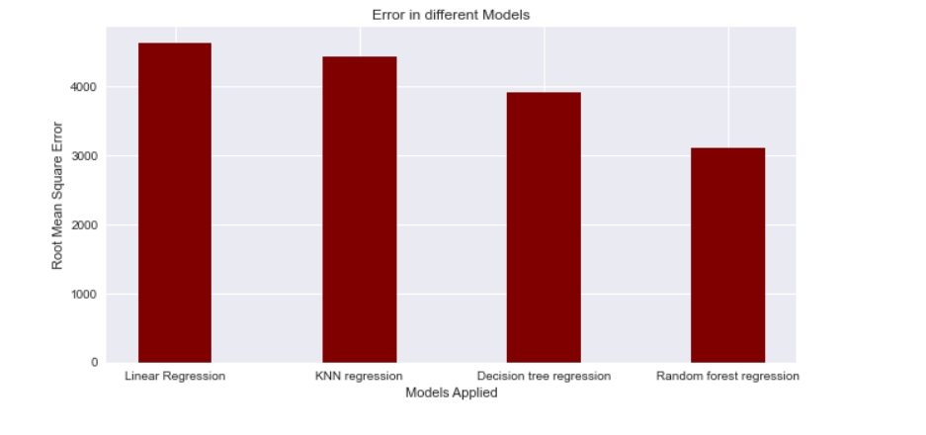
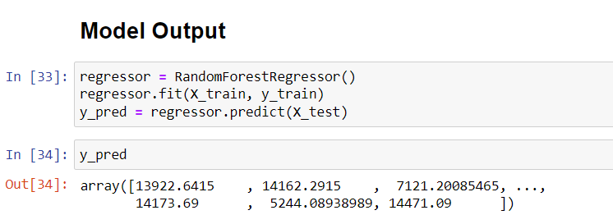
Final Output

Slide 23

Conclusion
With traditional methods not being of much help to business growth in terms of revenue, the use of Machine learning approaches proves to be an important point for the shaping of the business plan taking into consideration the shopping pattern of consumers.
Projection of sales concerning several factors including the sale of last year helps businesses take on suitable strategies for increasing the sales of goods that are in demand.

Slide 24

Future Scope
As future research, we apply different machine learning algorithms for optimal accuracy predictions and rise retail business sales revenue. Using these algorithms we can enhance customer-product relations and maintain good record of sales.

Slide 25
References
C. M. Wu, P. Patil and S. Gunaseelan, "Comparison of Different Machine Learning Algorithms for Multiple Regression on Black Friday Sales Data," 2018 IEEE 9th International Conference on Software Engineering and Service Science (ICSESS), 2018, pp. 16-20, doi: 10.1109/ICSESS.2018.8663760.
Odegua, Rising. (2020). Applied Machine Learning for Supermarket Sales Prediction.
K. Singh and R. Wajgi, "Data analysis and visualization of sales data,“ 2016 World Conference on Futuristic Trends in Research and Innovation for Social Welfare (Startup Conclave), 2016, pp. 1-6, doi: 10.1109/STARTUP.2016.7583967.
S. Yadav and S. Shukla, "Analysis of k-Fold Cross-Validation over Hold-Out Validation on Colossal Datasets for Quality Classification,“ 2016 IEEE 6th International Conference on Advanced Computing (IACC), 2016, pp. 78-83, doi: 10.1109/IACC.2016.25.
Purvika Bajaj1, Renesa Ray2, Shivani Shedge3, Shravani Vidhate4, Prof. Dr. Nikhilkumar Shardoor5,”SALES PREDICTION USING MACHINE LEARNING ALGORITHMS'',International Research
Journal of Engineering and Technology (IRJET) ,Vol 7 Issue 6,2020,e- ISSN: 2395-0056 | p-ISSN: 2395-0072

